Slide 1
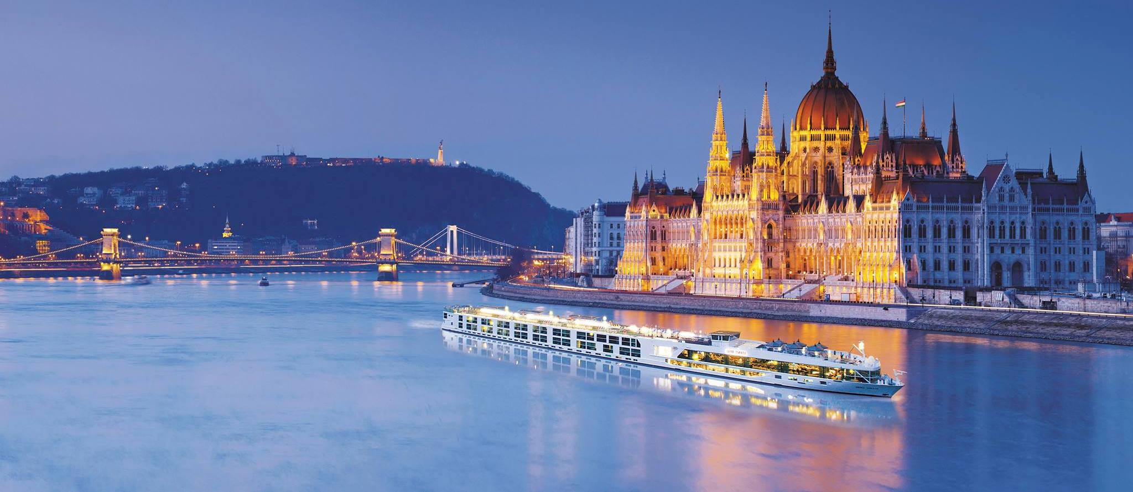
PebbleCreek Travel International Club April 24, 2018

Slide 2
Travel International Club Officers
Cindy Watty, President cindy@alfrescotravel.com
Diana Johnson, Vice-President ronanddiana@cox.net

Slide 3
Travel Quiz!!

Slide 4
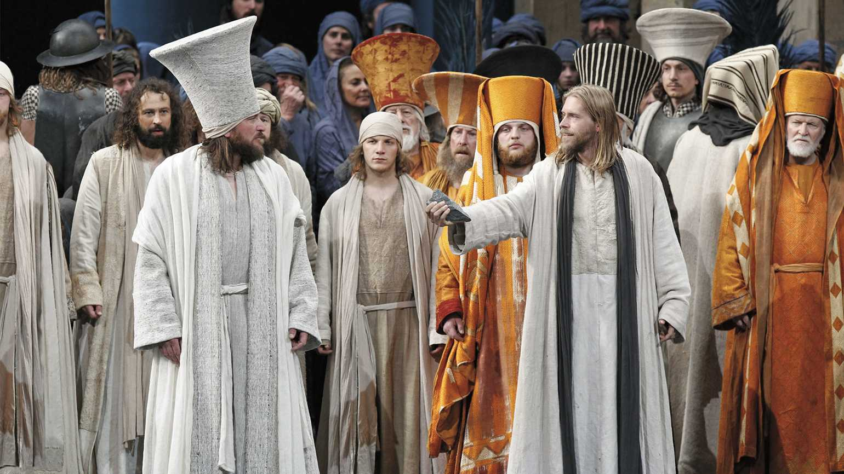
2020 Travel International Club trip
12-Day Avalon Waterways Danube Dreams Cruise with Guided tour of Innsbruck & Munich PLUS the Passion Play at Oberammergau Cruise begins: June 25, 2020

Slide 5
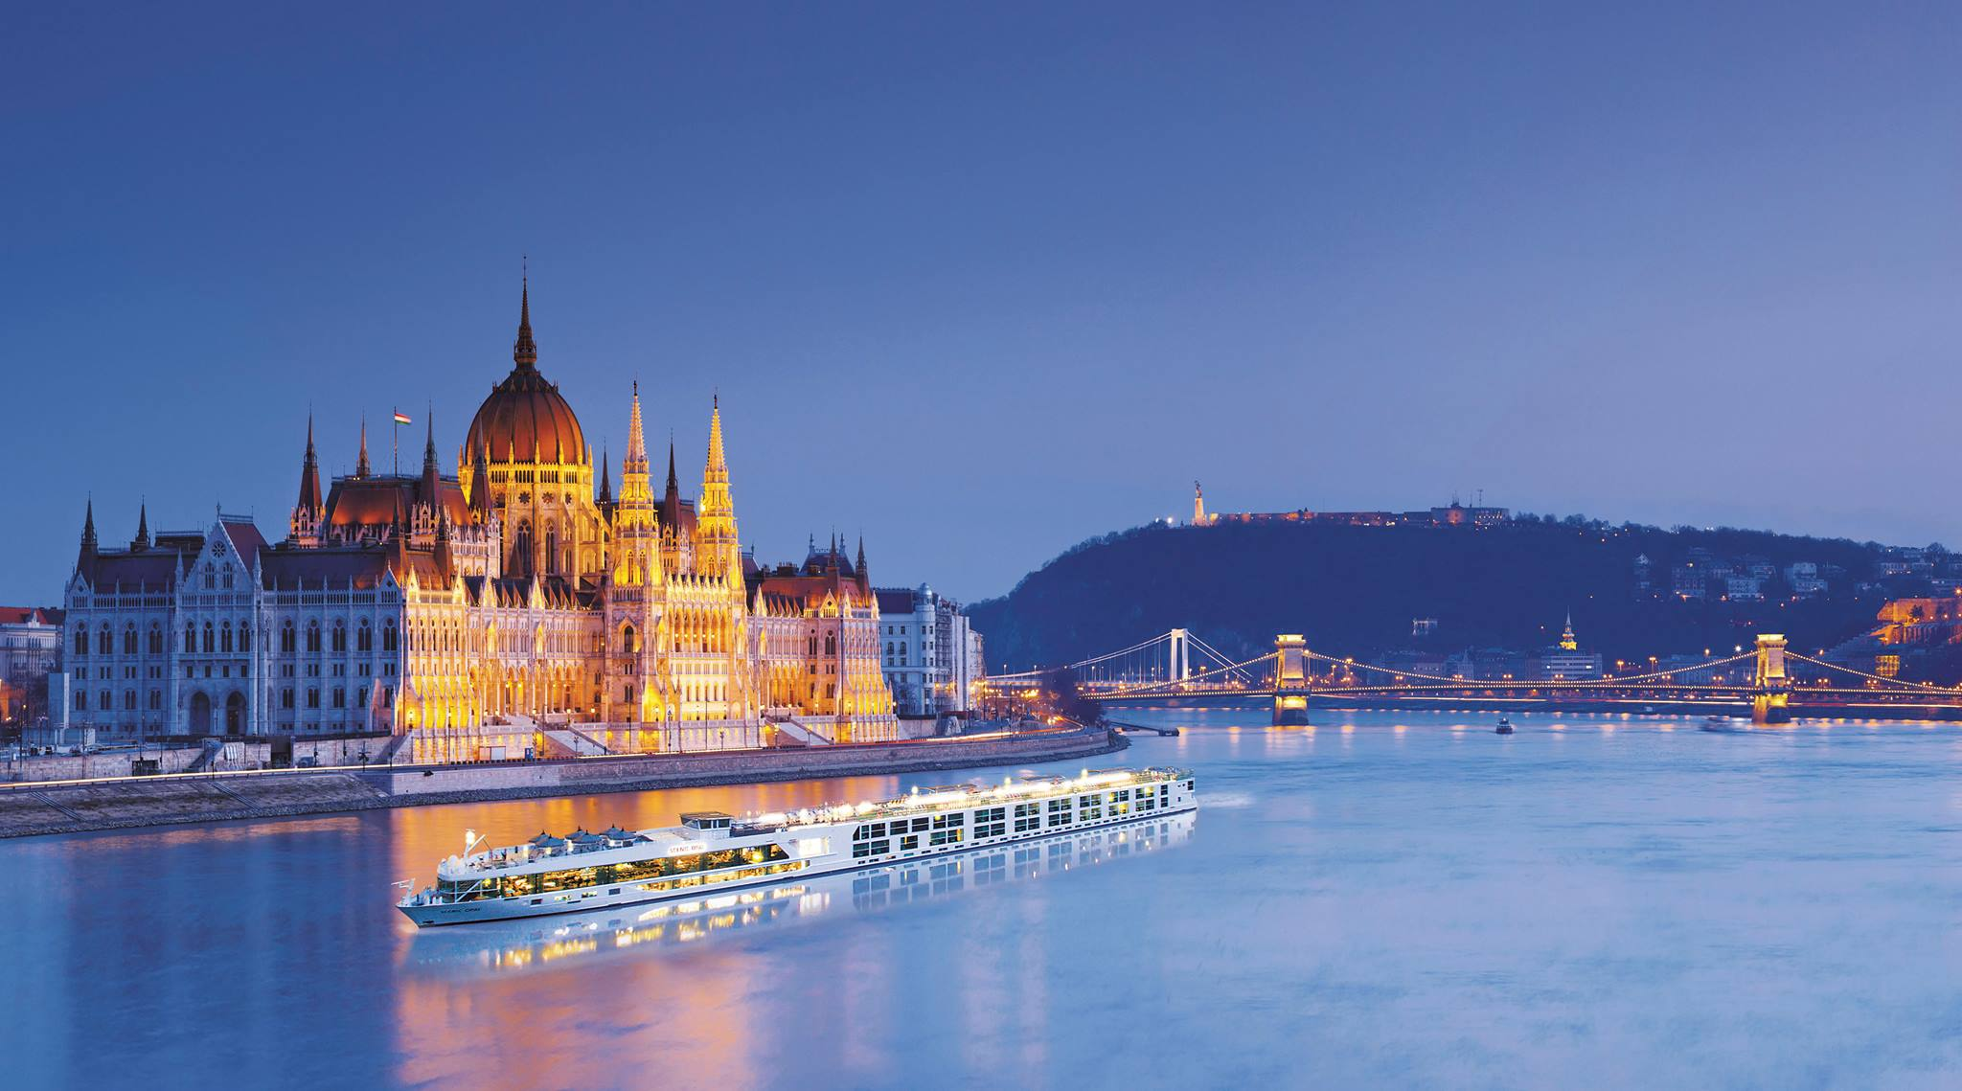
Day 1 & 2 – Budapest, Hungary
Embarkation and reception
Guided sightseeing to the Chain Bridge, St. Stephen’s Basilica and Heroes’ Square

Slide 6
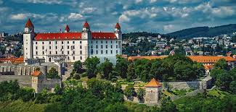
Day 3 – Bratislava, Slovakia
Guided sightseeing, explore its fascinating Old Town, where winding cobblestone streets and narrow alleyways
Visit St. Martin’s Cathedral

Slide 7
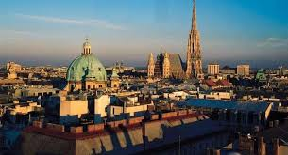
Day 4 – Vienna, Austria
Known as the “City of Music,” Vienna inspired the creative genius of Mozart, Beethoven, and Strauss.
Austria’s magical capital on the blue Danube is a showcase of gilded architecture

Slide 8
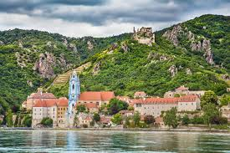
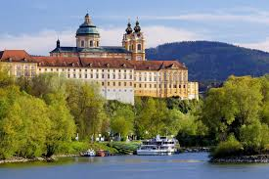
Day 5 – Durnstein; Melk
Choice of guided walk or hike up to the castle ruins in Dürnstein
Guided visit of the Benedictine Abbey in Melk; wine tasting

Slide 9
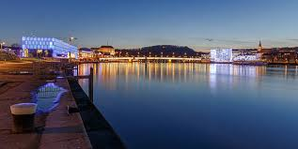
Day 6 – Linz, Austria
Austria’s third-largest city and enjoy a guided walk which shows you the highlights

Slide 10
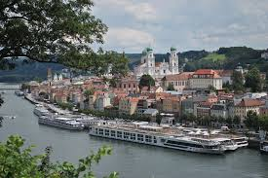
Day 7 – Passau, Germany
This is a “City of Three Rivers” filled with graceful arcades and cobblestone streets and dominated by St. Stephen’s Cathedral

Slide 11
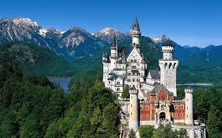
Day 8 – Deggendorf – Innsbruck
Disembarkation and travel from Deggendorf to Innsbruck, with visit to Neuschwanstein Castle

Slide 12
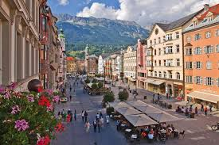
Day 9 – Innsbruck
Join your local guide for a morning guided sightseeing of Innsbruck, visit St. James Cathedral and the Hofkirche

Slide 13
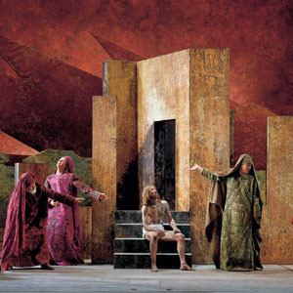
Day 10 – Innsbruck - Oberammergau
A motorcoach transfer will take you to Oberammergau for the highlight of the vacation: the original PASSION PLAY, which is performed every 10 years by the inhabitants of the village since 1634

Slide 14
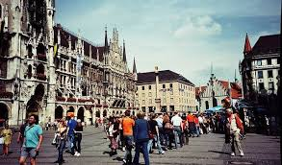
Day 11 & 12 – Munich
Although a large city, Munich oﬀers a small-town feel with its pedestrian- and bike-friendly atmosphere.
With its historical museums, splendid English Garden, traditional cafés, Munich oﬀers plenty to see and do

Slide 15
Avalon Waterways Danube Dreams with Oberammergau
12-Day Avalon Waterways Danube River Cruise including a guided tour of Innsbruck and Munich with the Passion Play at Oberammergau
June 25 to July 6, 2020
**Prices start at $5,365**

Slide 16
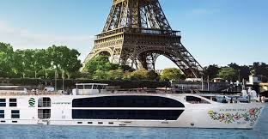
River Cruising in France Uniworld: Paris to Normandy April 21 – 28, 2019

Slide 17
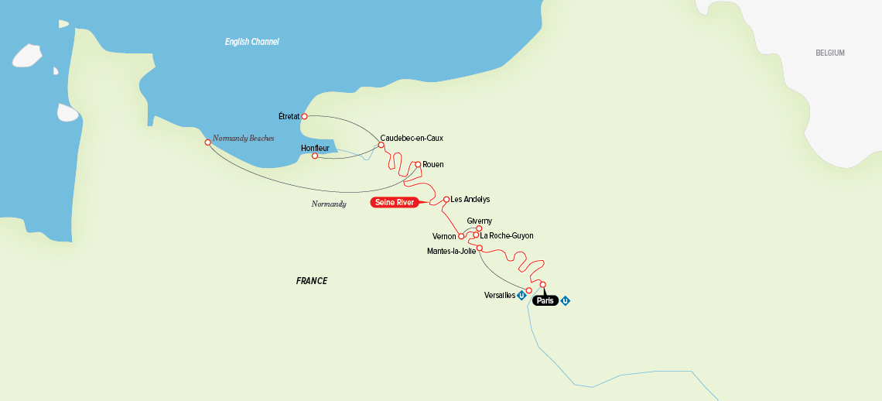
Uniworld: S. S. Joie de Vivre
Join us on the Joie de Vivre as we cruise from Paris to the beaches of Normandy.
75th Anniversary of the D-Day invasion

Slide 18
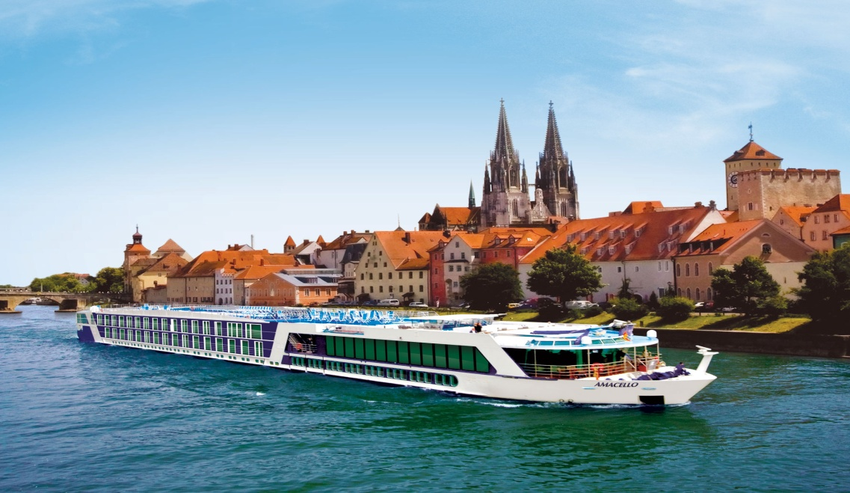
River Cruising in France AmaWaterways: Colors of Provence May 2 - 9, 2019

Slide 19
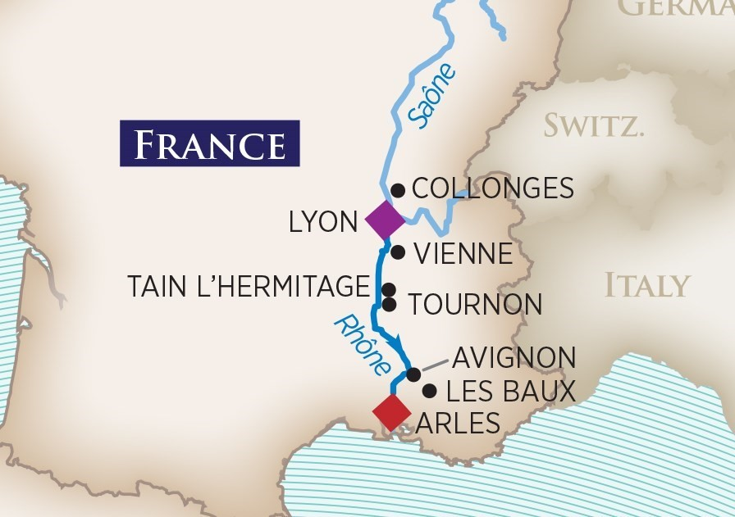
AmaWaterways: AmaCello
Join us on the AmaCello as we cruise from Lyon to the Arles in Provence.
Visit wineries in the Beaujolais, Bourgogne and Cotes du Rhone regions of France

Slide 20
These trips will fill quickly. Be sure to book early (like REALLY, REALLY SOON) if you plan to join us.
Book your cruise by April 30, and receive:
$200 off a suite
$100 off a French balcony
$50 off standard room (window)

Slide 21
PebbleCreek Travel International Club
2018 Trips

Slide 22
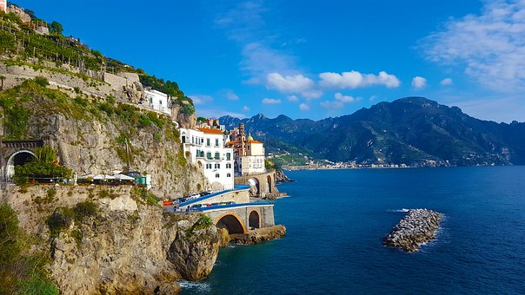
2018 Travel International Club trips
Enjoy an 11-day Guided Land Tour of the Amalfi Coast and Sicily
Sept. 29 – Oct. 9, 2018

Slide 23
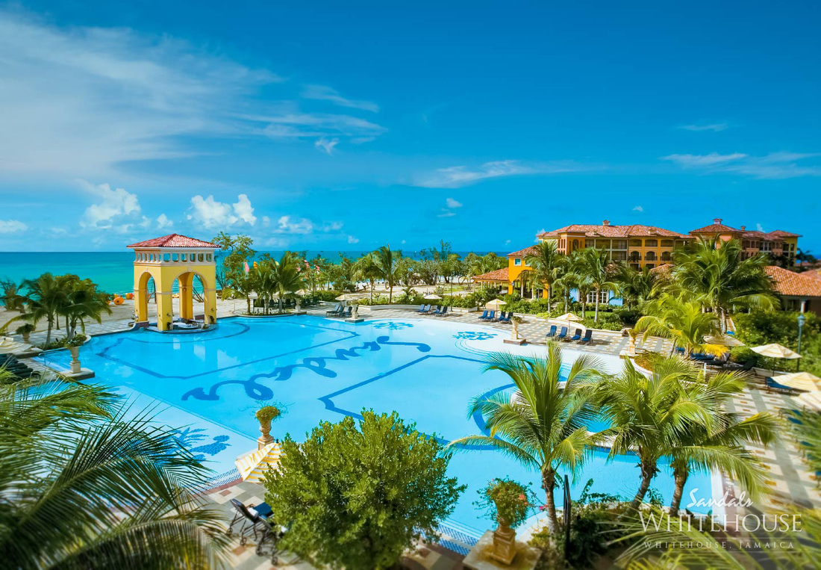
2018 Travel International Club trips
Pickleball in Jamaica!!!! Join us for a week of fun, sun and rum at Sandals South Coast Resort. December, 2018

Slide 24
PebbleCreek Travel International Club
For more information on any of our trips visit: www.alfrescotravel.com or email: Cindy@alfrescotravel.com

Slide 25
American Cruise Line
American Cruise Lines offers a variety of captivating cruise itineraries throughout the United States, including the Mississippi River region, Southeast, Northeast, Pacific Northwest, and Alaska with 15 Themed Cruises including Thanksgiving, Christmas and New Years Cruises, New England Lobsterbake, CrabFest, Food and Wine and Culinary cruises

Slide 26
Should I Use a Travel Agent?
In this age of online travel agencies, people often ask me why they need a travel agent. As an agent, I work on your behalf. There are many reasons to utilize my services. And contrary to popular belief, these services are completely free to you!

Slide 27
Personalized Service
I will take the time to listen to exactly what it is you want. In the process of working together, I will be able to understand the experience you are searching for. You will always have someone to go to with your questions. No matter how advanced technology becomes, the Internet will never be able to provide this level of personalized service.

Slide 28
Expert Guidance
I am able to provide valuable advice and expert guidance because I deal with travel every day. I have visited all the areas that I sell and have toured many of the resorts and hotels. Additionally, I network with other agents, benefiting from their experiences and expertise.

Slide 29
Customer Advocacy
If you encounter problems with any part of your travel experience, I will be there to advocate for you. I write the hotel before your arrival and am sometimes able to secure additional perks such as special amenities or upgrades.

Slide 30
Save Your Time for Travel
With the wealth of information available online, you could spend hours in front of your computer searching for that perfect getaway. And unless you have booked this trip on your own a hundred times before, utilizing the knowledge and expertise of a travel specialist is a far better choice. It will also save you hours of work and perhaps help you avoid making a costly mistake.

Slide 31
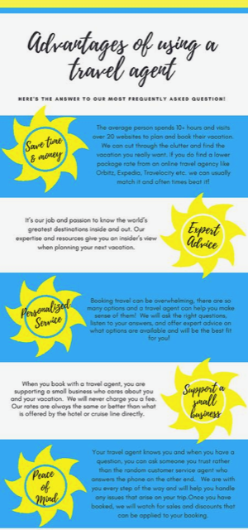
Advantages of Using a Travel Agent

Slide 32
For any of your travel questions please visit:
www.alfrescotravel.com
email: Cindy@alfrescotravel.com

Slide 33
PebbleCreek Travel International Club
No Meetings until the Fall
Enjoy your Summer Travels

